Slide 1

Car-pooling management system
Group 12
Charan Kumar Chaganaboina
Karunakar Gaddam
Girish Reddy Madireddy
Rahul Reddy Pothireddy
Sandeep Reddy Yeddula

Slide 2
Agenda
Introduction & Motivation
Problem Statement
Project Objectives
System Architecture
Key Modules & Features
Entity Relationship Diagram
UI Screens
Testing & Results
Conclusion & Future Work

Slide 3
Introduction & Motivation
With the rise in urban population, traffic congestion and pollution have become serious issues.
Traditional carpooling lacks a structured and secure system.
This project aims to create a digital carpooling platform using Python (CustomTkinter) and MySQL.
It helps passengers and drivers connect in real-time, reducing travel costs and carbon footprint.
The CMS bridges the gap between informal carpooling and smart transport solutions by offering a structured, centralized platform that automates ride discovery, booking, and management.
By combining real-time scheduling, dynamic matching, and encrypted role-based access, the system ensures safety, trust, and scalability for urban commuters.

Slide 4
Problem Statement
Manual coordination of carpools is inefficient and error-prone.
Lack of authentication and scheduling makes traditional systems unreliable.
There is a need for a centralized, user-friendly platform for ride sharing.
Existing solutions often lack scalability and fail to support concurrent access or dynamic updates, making them unsuitable for large urban environments.
Inadequate data security and poor user verification in traditional systems reduce trust and discourage adoption.
Absence of analytics or reporting features limits visibility into ride efficiency, cost savings, and environmental impact.

Slide 5
Project Objectives
Develop a secure, scalable, and responsive carpooling system.
Facilitate role-based access for drivers and passengers.
Enable real-time ride creation, booking, and tracking.
Ensure robustness through proper testing and error handling.
Integrate a user-friendly interface with intuitive navigation and visual feedback using CustomTkinter.

Slide 6
System Architecture
Frontend: Python with CustomTkinter for GUI.
Backend: MySQL database for storing user and ride information.
Architecture: Follows the MVC pattern for modularity.
Security: Role-based access, input validation, rollback mechanisms.

Slide 7
Key Modules & Features
User Authentication & Registration with role assignment.
Ride Creation & Booking with date and location filters.
Driver and Passenger Dashboards.
Report generation and historical data tracking.

Slide 8
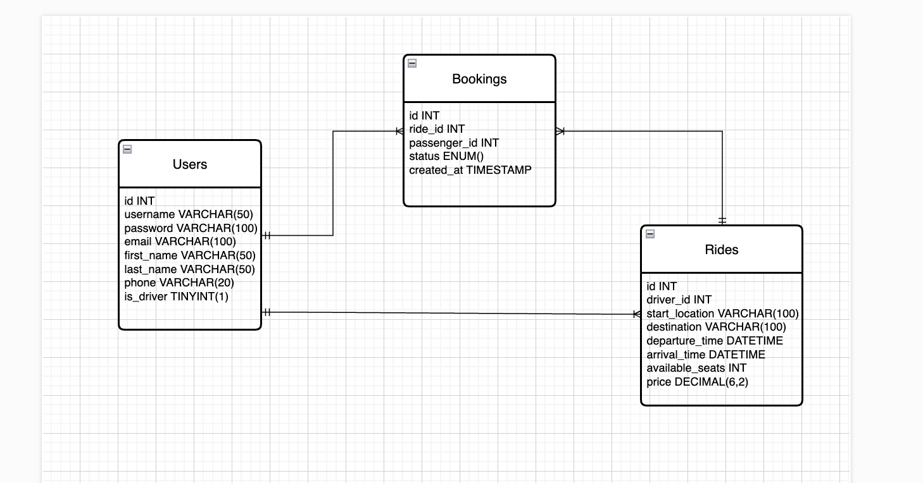
Entity Relationship Diagram

Slide 9
UI Screens
Registration and Login Screens.
Driver Dashboard: Create and manage rides.
Passenger Dashboard: Book and view rides.
Modern, responsive interface using CustomTkinter and tkcalendar.

Slide 10
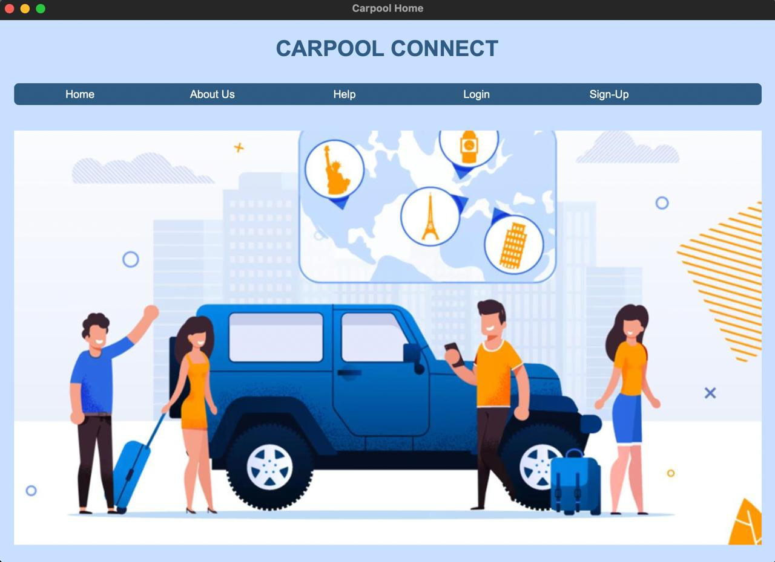
Home page

Slide 11
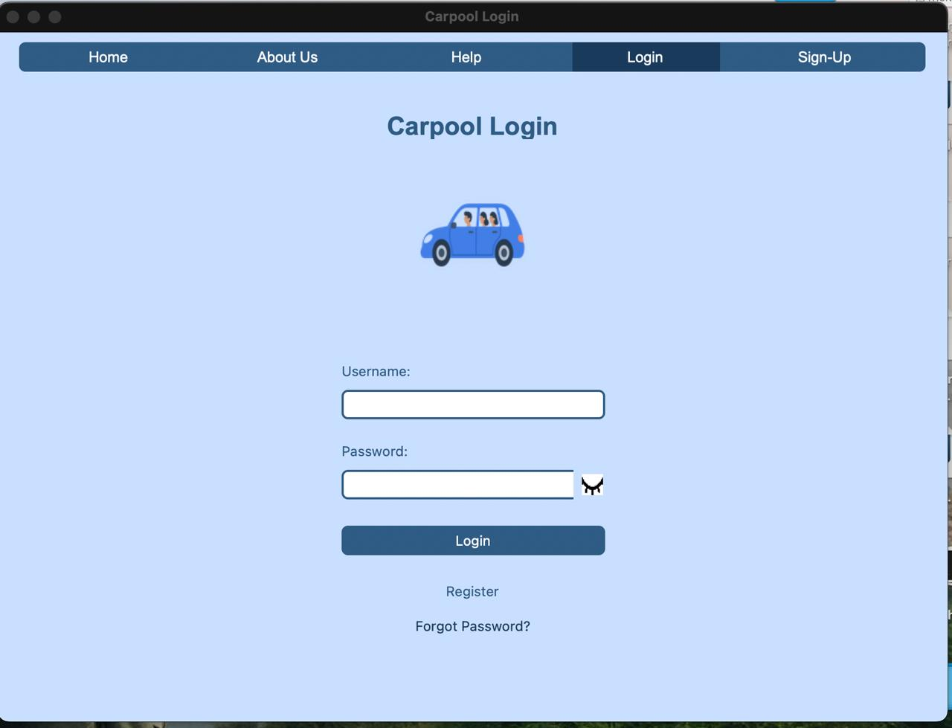
Login page

Slide 12
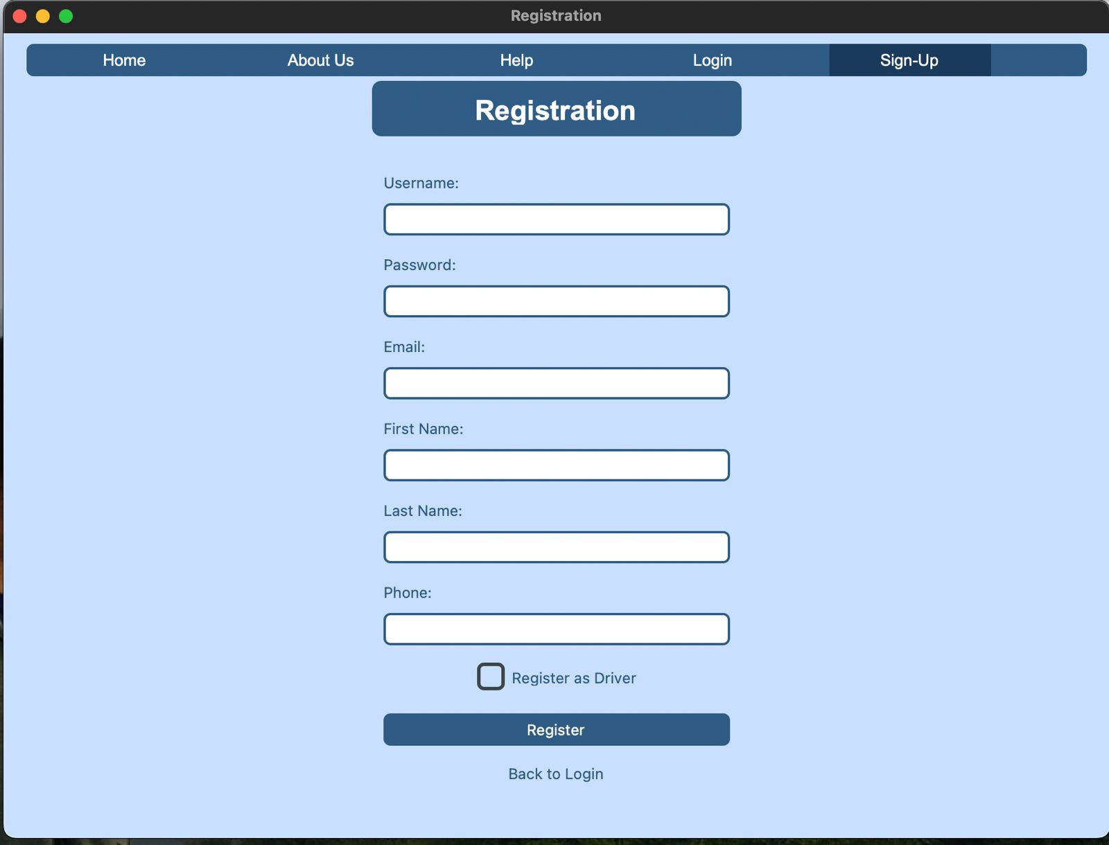
Signup page

Slide 13
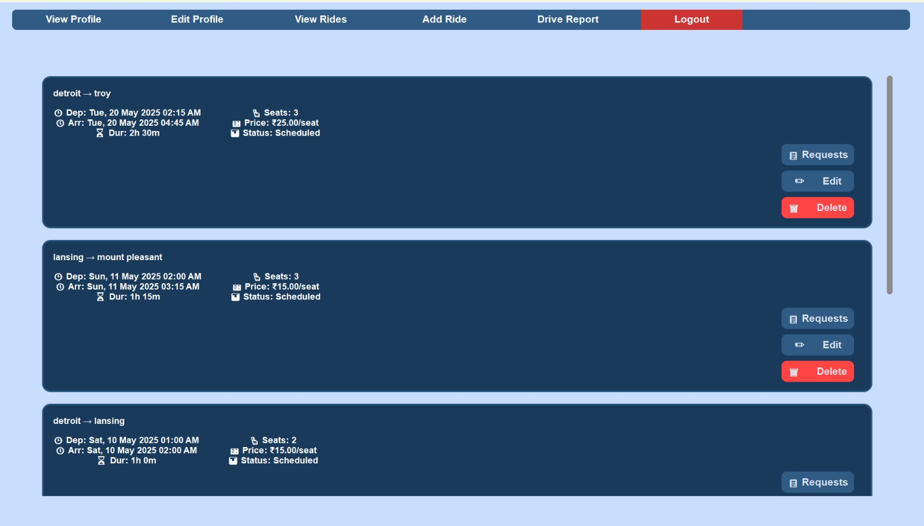
Driver dashboard

Slide 14
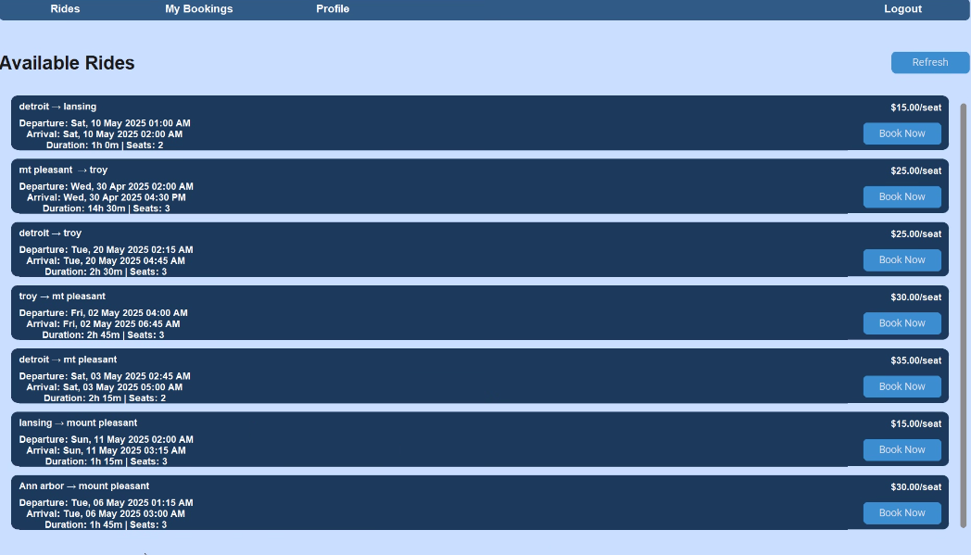
User Dashboard

Slide 15
Testing & Results
Tested with 10+ use cases including login, ride creation, booking, and input validation.
Handles over 1000 concurrent users effectively.
Secure against SQL injection and incorrect data submissions.

Slide 16
Conclusion & Future Work
CMS successfully provides a digital platform for structured carpooling.
Reduces traffic, pollution, and travel cost.
Future enhancements: GPS integration, mobile version, payment gateway, user reviews.

Slide 17

THANKS FOR YOUR RIDE

